Slide 1
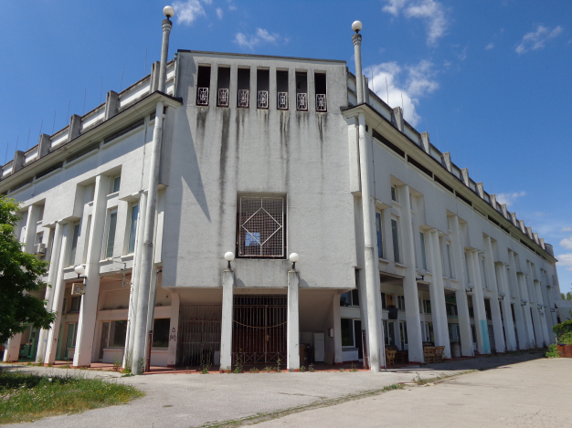
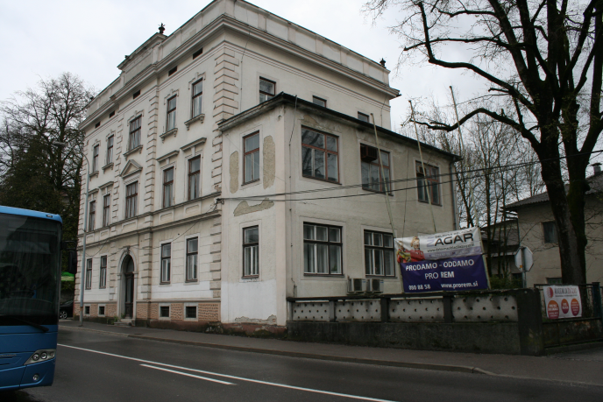
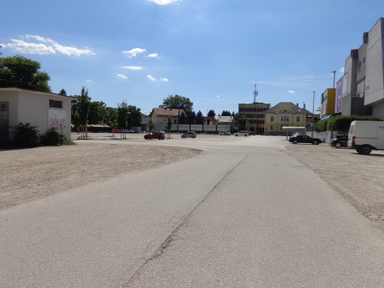
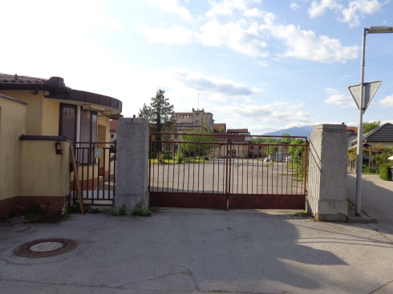
APP ON FUNCTIONAL DERELICT AREAS (GIS)
Maša Iskra

Slide 2

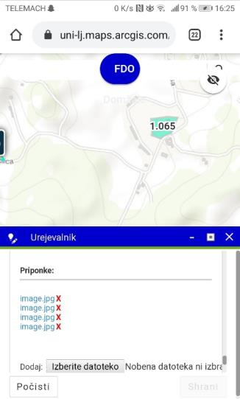
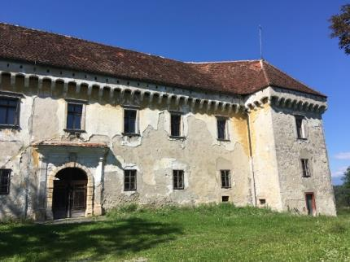
Purpose of application:
Possible entry of information online, changes
Clearly collected data
Accessibility (phone, computer, different locations)
View photos at the same time
Better communication
Data export and further processing

Slide 3
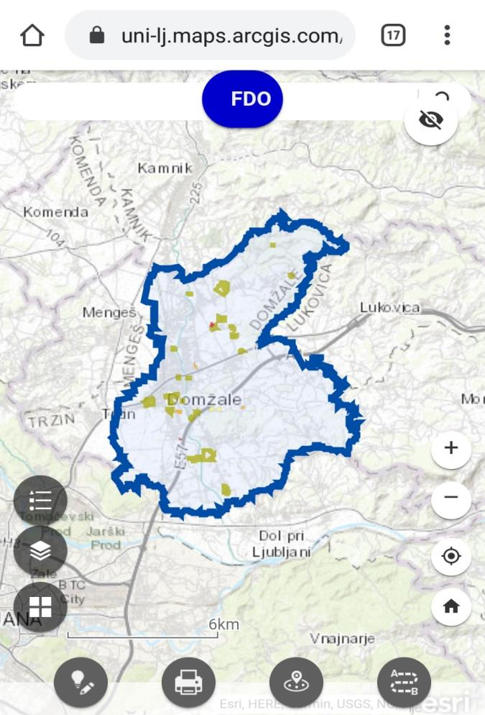
When we open the program we see the municipality of Domžale marked . All these spots in the municipality represent functional derelict areas (FDA).

Slide 4
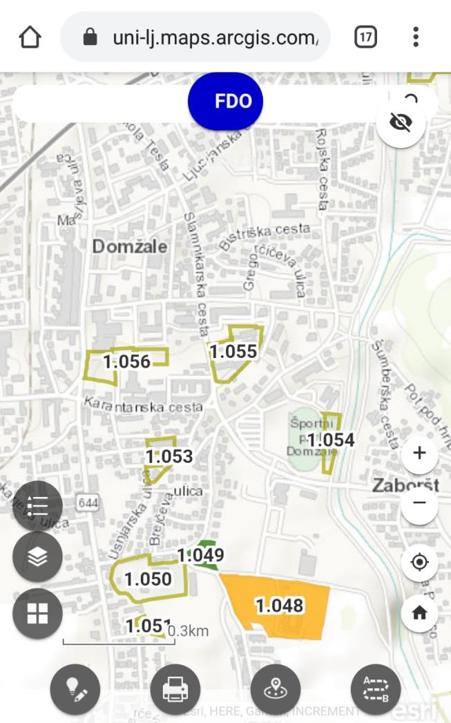
When you zoom in, all FDAs are identified by IDs for easier orientation.

Slide 5
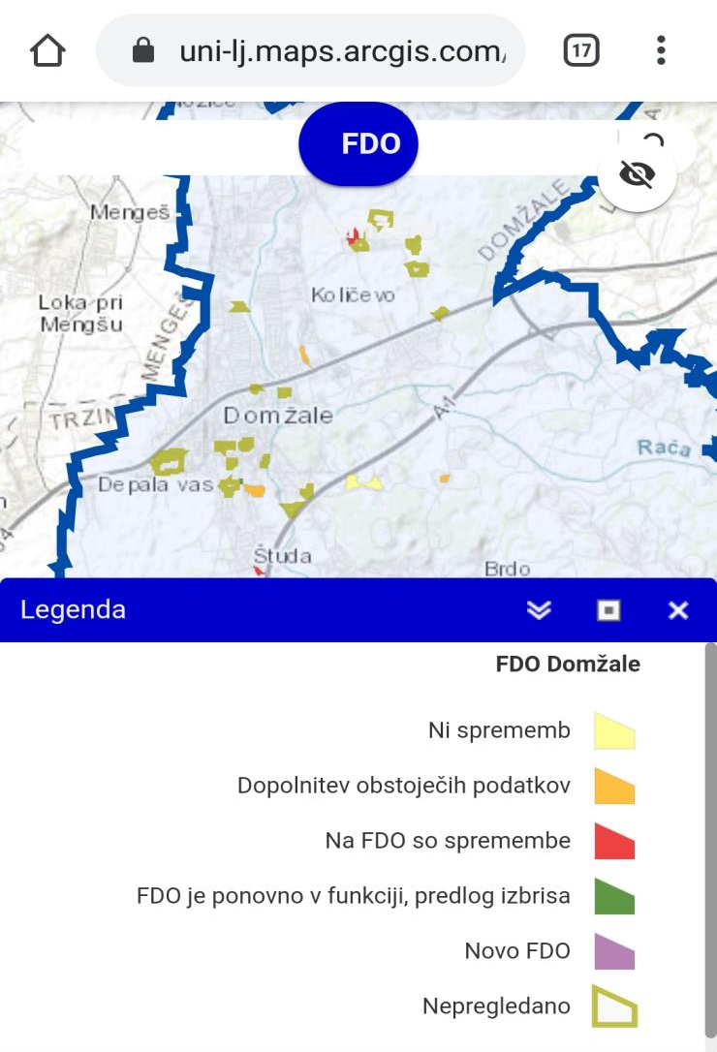
Different colors tell us the states of a FDA.
No change
Adding existing data
Changes on FDA
FDA in function again, deletion proposed
New FDA
Unrevised

Slide 6
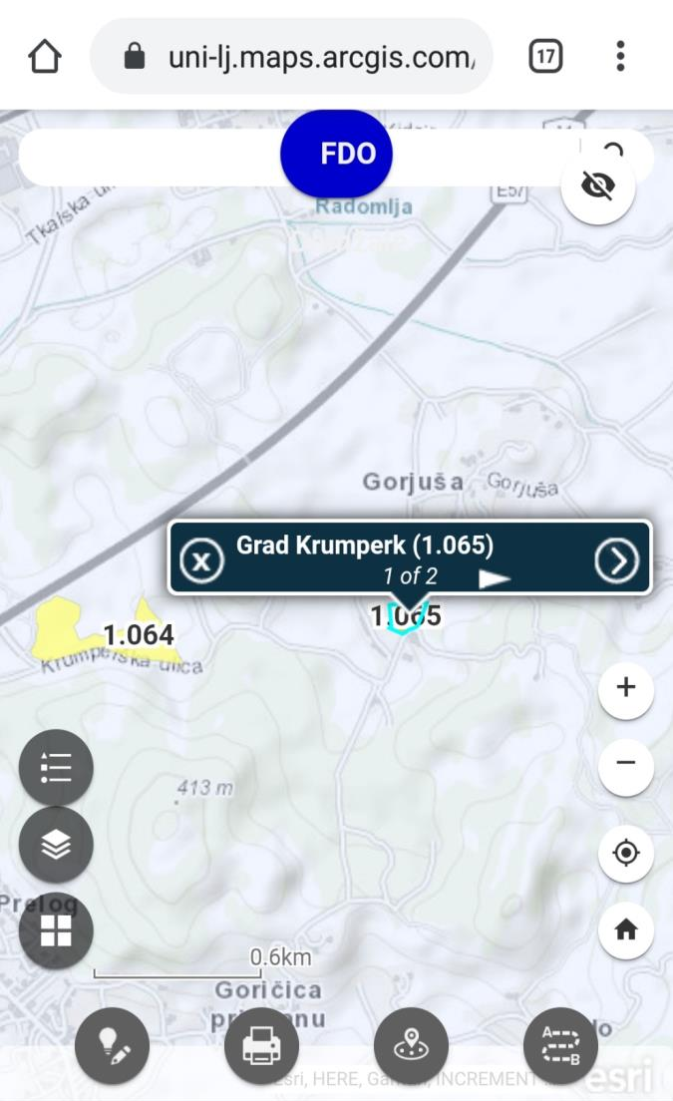
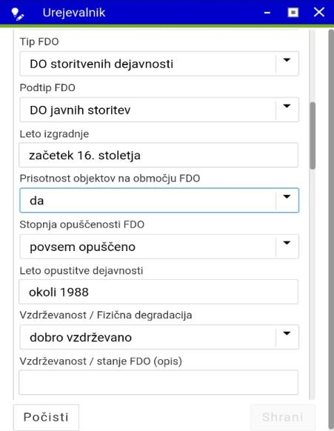
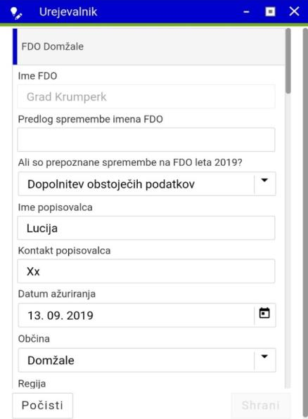
When we find the area that we want to study in greater detail, we can click on the area and questionnaire with data on FDA will open.

Slide 7
Link:
https://uni-lj.maps.arcgis.com/apps/webappviewer/index.html?id=868a75141f554f1f874993bf9882a051
User: ff_domzale
Password: domzale_fdo19

